Slide 1
Models for Software Process Improvement

Slide 2
Software Process - Overview
Objectives for Process Improvement
History of Process Models
Models (CMM, ISO, IEEE)
Best Practices
“Good-enough” Software

Slide 3
Software Process: Objectives
schedule (delivery date)
functionality
(features)
quality
(defects)

Slide 4
Software Process: History
1980s DoD Std 2167, AQAP 13 (NATO), industry standards (nuclear)
1983 IEEE 730 (software quality assurance plans)
1987 ISO 9000
1988 TickIT (ISO 9001)
1990 ISO 9000-3 (guideline for software)
1991 Capability Maturity Model (CMM)
1992 SPICE (ISO 15540)

Slide 5
Software Process: History
State-of-the-art software practices in 1984, for large software systems [Jones, 1995]:
More than half were late in excess of 12 months
Average cost was more than twice the initial budget
Cancellation rate exceeded 15%
Quality and reliability was poor, for both small and large projects
Software personnel were increasing by more than 10% per year
Software was the largest known business expense that could not be managed

Slide 6
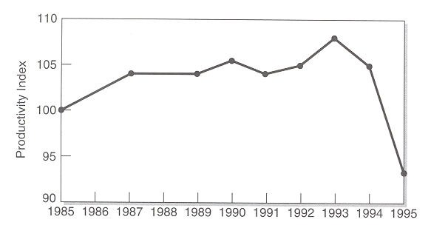
Software Process: Productivity
U.S. Software Development – Productivity Trends [Yourdon]

Slide 7
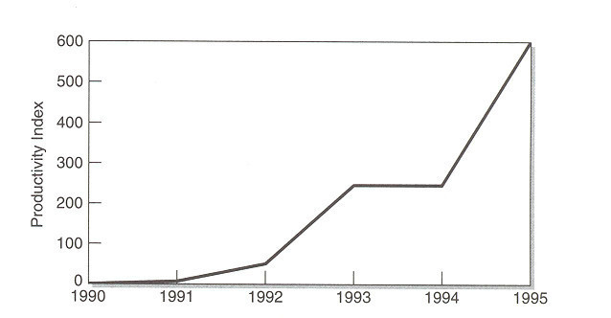
Software Process: Productivity
Range of Productivity at Enterprise Level [Yourdon]

Slide 8
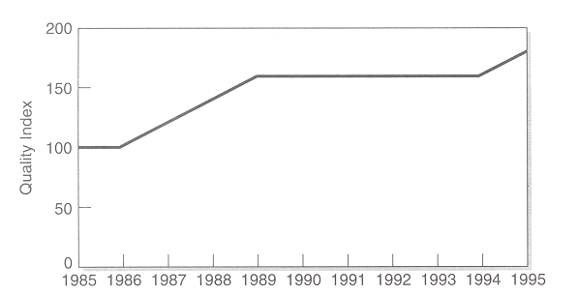
Software Process: Quality
U.S. Software Development – Quality Trends [Yourdon]

Slide 9
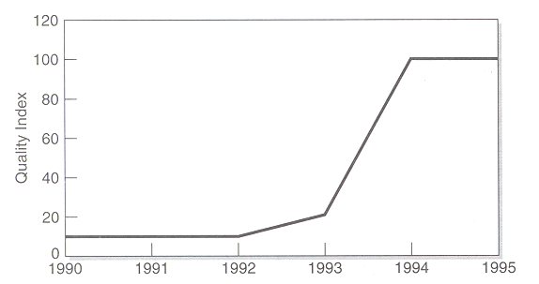
Software Process: Quality
Range of Quality at Enterprise Level [Yourdon]

Slide 10
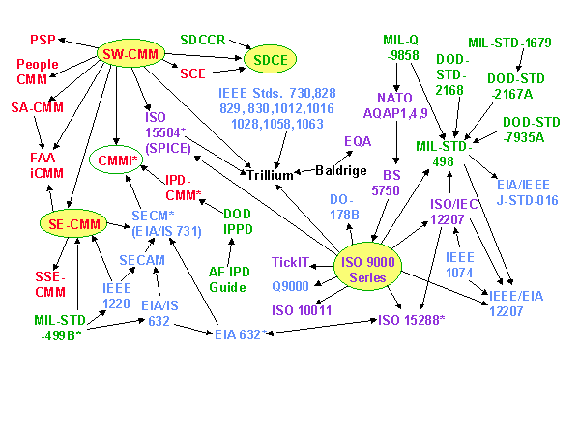
Software Process: Models
CMM
U.S. DoD
ISO
Industry, professional
(c) 1998 Software Productivity Consortium MFP, Inc. All rights reserved.
Refer: http://www.software.org/quagmire/

Slide 11
Software Process: CMM
Developed by Software Engineering Institute (SEI), Carnegie Mellon
Funded by U.S. DoD, concerned with late and cancelled contracts (A12, $58 billion)
For large projects, contractors must be assessed at Level 3 or DoD equivalent (October 1999)
Capability Maturity Model for Software (SW-CMM) v1.1, February 1993.

Slide 12
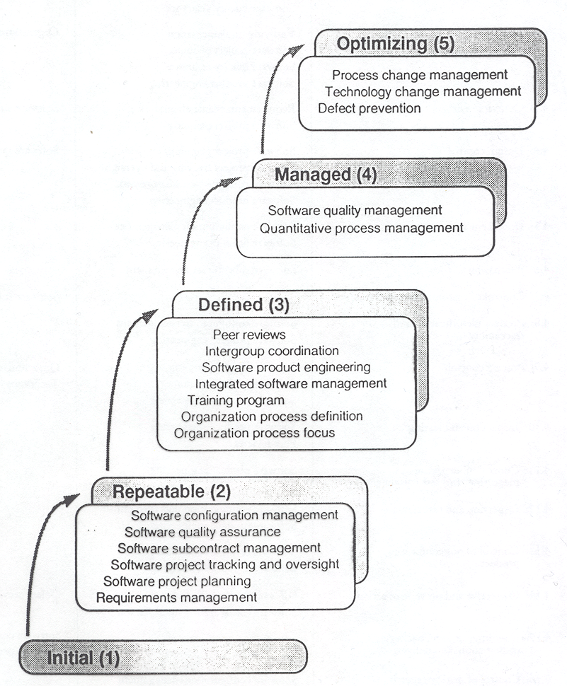
Software Process: CMM
Maturity level (historical, continuous improvement)
Key process
Key practice (infrastructure, activities)

Slide 13
Software Process: CMM
Initial. The software process is characterized as ad hoc, and occasionally even chaotic. Few processes are defined, and success depends on individual effort and heroics.
Repeatable. Basic project management processes are established to track cost, schedule, and functionality. The necessary process discipline is in place to repeat earlier successes on projects with similar applications.
Defined. The software process for both management and engineering activities is documented, standardized, and integrated into a standard software process for the organization. All projects use an approved, tailored version of the organization's standard software process for developing and maintaining software.
Managed. Detailed measures of the software process and product quality are collected. Both the software process and products are quantitatively understood and controlled.
Optimizing. Continuous process improvement is enabled by quantitative feedback from the process and from piloting innovative ideas and technologies.

Slide 14
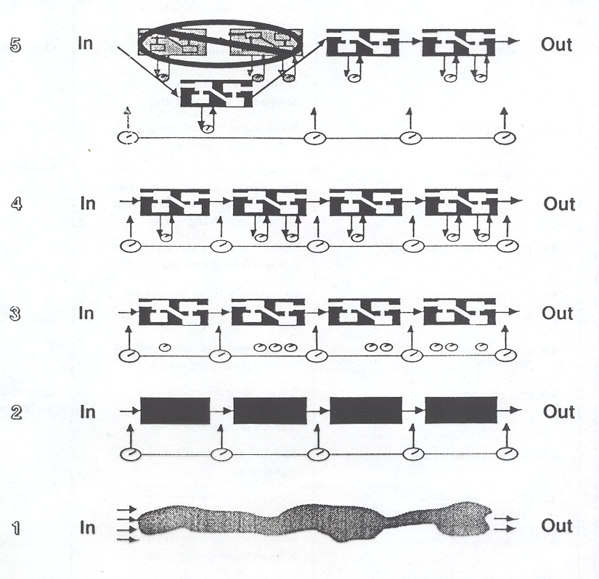
Software Process: CMM
Processes are managed, controlled

Slide 15
Software Process: CMM
Defects
0
quality := 0 defects
1
2
3
4
Process

Slide 16
Software Process: CMM
0.5%
[Jones, 1995]
1.5%
8.0%
15.0%
75.0%

Slide 17
Software Process: PSP
Personal Software Process (PSP), Watts Humphrey, SEI
Process model for individual programmers or small companies
Detailed examples of key practices, including software metrics

Slide 18
Software Process: ISO
International Organization for Standardization, 130 countries
Including Canada (SCC) and U.S (ANSI)
ISO 9000 – guidelines and standards for process control
Sector-independent (applies to any product or service)

Slide 19
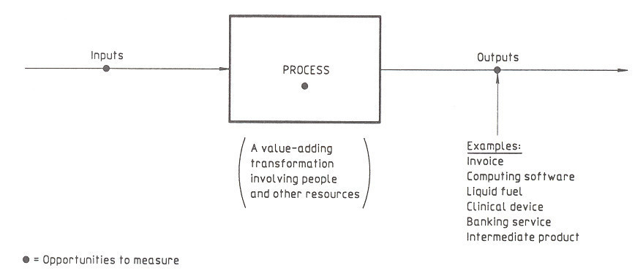
Software Process: ISO

Slide 20
Software Process: ISO
Three “models” of a quality management system for a product or a service:
ISO 9001 (1994) – Model for quality assurance in design/development, production, installation, and servicing
ISO 9002 (1994) - Model for quality assurance in production and installation
ISO 9003 (1994) - Model for quality assurance in final inspection and test

Slide 21
Software Process: ISO
ISO 9001 (Scope):
used where a supplier's capability to design and supply conforming product needs to be demonstrated.
aimed primarily at achieving customer satisfaction by preventing non-conformity at all stages from design through to servicing

Slide 22
Software Process: ISO
quality := totality of characteristics of an entity (process, product, organization) that bear on its ability to satisfy stated and implied needs (ISO 8402)

Slide 23
Software Process: ISO
Framework Life-cycle Support
Management responsibility Contract review Configuration management
Quality system Requirements specification Document control
Internal QS audits Development planning Quality records
Corrective action Quality planning Measurement
Design and implementation Rules, practices and conventions
Testing and validation Tools and techniques
Acceptance Purchasing
Delivery and installation Included software product
Maintenance Training
minimum best practices

Slide 24
Software Process: TickIT
Registration scheme for software in Britain and Sweden
Certificates are issued against ISO 9001
Assessors and auditors are software professionals

Slide 25
Software Process: SPICE
Software Process Improvement and Capability dEtermination (ISO 15540)
ISO standard will “harmonize” ISO and CMM

Slide 26
Software Process: SPICE
5 process categories
40 processes/sub-processes
[Duncan, 1998]

Slide 27
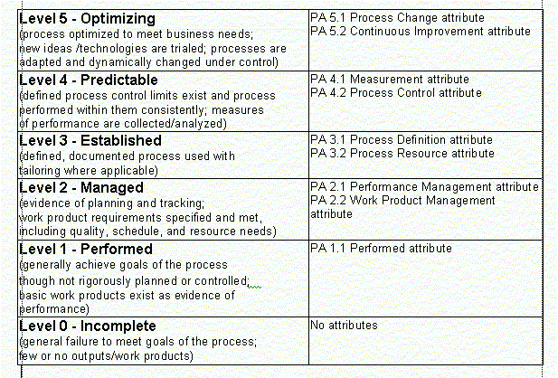
Software Process: SPICE
For a given process to achieve a Level, all lower level attributes must be Fully met and all attributes at the target level must be Fully or Largely met
[Duncan, 1998]

Slide 28
Software Process: IEEE
How to implement a life-cycle model?
730 Software Quality Assurance Plans
828 Software Configuration Management Plans
829 Software Test Documentation
830 Software Requirements Specifications
1008 Software Unit Testing
1016 Software Design Descriptions

Slide 29
Software Process:Best Practices
Best Practices project, DoD, 1994
Focus on practices instead of complex regulations
Encourage flexibility within disparate environments
Identified 170 best practices
URL: http://spmn.com/ (Software Program Managers Network )

Slide 30
Software Process: Best Practices
Formal risk management
Agreement on interfaces (user manual as specification)
Formal inspections
Metric-based scheduling and management
Binary quality gates at the inch-pebble level
Program-wide visibility of progress vs. plan
Defect tracking against quality targets
Configuration management
People-aware management accountability (qualified staff, high morale, low turnover)

Slide 31
Software Process: Good-enough Software
schedule (delivery date)
functionality
(features)
quality
(defects)

Slide 32
Software Process: Good-enough Software
Target is “feature-richness”
Customer (marketing) decides the balance between schedule, functionality, quality
Processes are dynamic, evolutionary
Depends on best practices, e.g., user manual, peer reviews, daily build
Depends on guerilla programmers

Slide 33
Software Process: Conclusion
no best model, none is complete
people are key (managers, quality managers, developers)
bottom-up vs top-down (cost, infrastructure)
reasons:
business requirement (certification)
productivity (better, cheaper, faster)

Slide 34
Software Process: References
http://www.sei.cmu.edu/ (Software Engineering Institute)
http://www.iso.ch/ (International Organization for Standardization (ISO))
http://www.sqi.gu.edu.au/spice/ (SPICE, Software Quality Institure)
http://www.tickit.org/index.htm (TickIT, British Standards Institute)
http://www.scc.ca/iso9000/index.html (Standards Council of Canada, ISO)
http://strategis.ic.gc.ca/ (ISO 9001 Registration for Small and Medium-Sized Software Enterprises, Industry Canada)
http://www.computer.org/standards/ (IEEE Computer Society,)
http://www.ieee.org/index.html (IEEE Home)

Slide 35
Software Process: References
http://www.nbita.org/spin/index.html (NBITA)
http://www.spc.ca/ (Software Productivity Center Inc)
http://www.software.org/ (Software Productivity Consortium)
http://www.rspa.com/spi/ (Software Engineering: A Practitioner's Approach, R.S. Pressman & Associates, Inc)
http://www.spr.com/index.htm (Software Productivity Research, Capers Jones)
Jones, Capers. “Gaps in SEI Programs”, Software Development, March 1995
http://catless.ncl.ac.uk/Risks (The Risks Digest, P.G. Neumann)
http://stsc.hill.af.mil/doc/resources.asp (MIL-STD-498 documents)
Duncan, S.P., “Standards & Models”, HTML document, http://www.mindspring.com/~softqual/stdsmods.html, 1998

